Slide 1

Welcome to Whitehall Junior School

Slide 2

Welcome to Whitehall Junior School

Slide 3
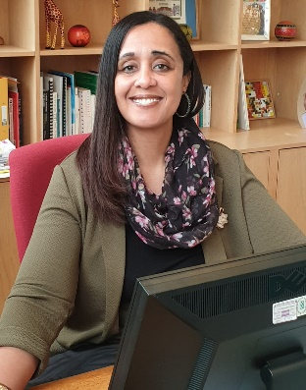
Meet the team
Welcome to Whitehall Junior School where ‘Happiness is at the heart of Learning’.
I am Mrs Moloi, your Headteacher.

Slide 4
Meet the team
Members of our Senior Leadership Team
Mrs Moloi | Headteacher/ DSL
Mrs Upfield | Deputy Headteacher
Miss Costa | Assistant Headteacher
Mrs Huse | SENDCo/ Deputy DSL (Likely to change in Sep.)

Slide 5
Meet the team
Safeguarding Team:
Mrs Moloi (Designated Safeguarding Lead)
Mrs Huse (Deputy Safeguarding Lead)
Mrs Simmonds (Wellbeing & Attendance Officer)

Slide 6
Meet the team
Mrs Treanor (Welfare Assistant & Admissions Officer)
Ms Chick (Receptionist & Front of House)
Other Key Personnel:
Mrs Tudorescu (School Business Manager)

Slide 7
Year 3 Team
Year 3 Lead & Teacher: Miss Mattera/TA
Mrs Norman (M-W) & Ms Guernieri (W-F)/ TA
Class 3L
Mx Spacey-Mageean/ TA
Class 3L
Class 3B
Class 3C
HLTA
Mr Keegel/ TA
Miss Boultwood

Slide 8
Our School Values
Bravery (persevering when things are difficult, facing learning challenges)
Respect (respect for ourselves and others)
Integrity (being honest and trustworthy)
Determination (challenging ourselves to improve)
Generosity (thoughtfulness, co-operation, and emotional growth)
Excellence (taking pride in everything we do)
A bridge takes us to new places and overcomes obstacles.
Together, we build bridges.

Slide 9

Our School’s Successful Ofsted

Slide 10

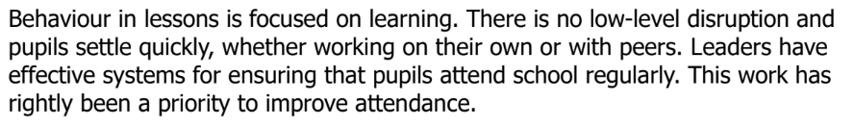
Our School’s Successful Ofsted

Slide 11

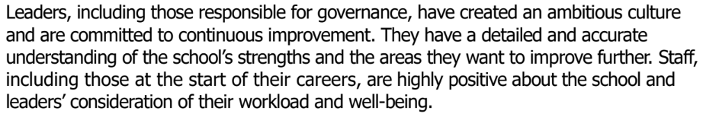
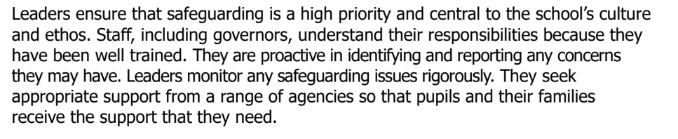
Our School’s Successful Ofsted

Slide 12
Timings of day
8:50 AM
School day begins: 8:50am *soft start from 8:35am*
9:00 AM
Assembly: 9:00am (Mon/Wed/Fri)
Morning
Play: 10:30am-10:45am
Lunch
12:15pm-13:15pm
3:15 PM
End of day

Slide 13
What is a junior school?
Operate Year 3-6
Only Key Stage 2 Curriculum
Introduction of Modern Foreign Language- French
All aspects of the National Curriculum covered (Computing)
Attendance- important & compulsory
Links to local secondary schools
Introduction of swimming in Year 5

Slide 14
Lunch
Hot dinners or Packed Lunch
Company: The Pantry
Food cooked in our kitchen
Order through: EduSpot Online booking & payment system
Packed lunches (Healthy and free of chocolates, chocolatey treats/ sweets)
Should contain a sandwich or perhaps to send in a food flask (no microwaves)
All children entitled to FREE hot dinners

Slide 15
What your child will need
School’s book bag or backpack
PE kit bag
Snack for playtime: Optional
Correct school uniform
Stationery: for homework (pencil, glue sticks, colouring pencil, scissors)

Slide 16
What to expect in early days?
Morning drop-off: arrive on time (gates open at 8:35am)
Our friendly staff are available in the playground, allowing parents to drop off and go
Advisable once children have settled in well
Staff will liaise with you should child not be settling in well
Year 3 drop-off and pick-up zone
Expect a few tears in initial stages

Slide 17
Changes to the end of school day
Junior School
End of day: 3:15pm
Pick up from field where dismissed to parent/ carer
Unless collecting a sibling at WIS, enter via back gate on Whitehall Road
Move to allow Year 5s (NEW) and Year 6s to go home unaccompanied

Slide 18
Out-of-hours provision
We run an internally run Breakfast Club for Y3-6
Breakfast Club runs from 7:30am-8:30am (breakfast provided)
Wraparound care: New in September
(Super Star Sports)
3:15pm-5:15pm
Accept tax-free childcare vouchers

Slide 19
Behaviour Expectations
READY
RESPECTFUL
SAFE

Slide 20
Communication & concerns
Day-to-day concerns: pop note into planner or speak to staff at the end of the day.
Mornings operate on a drop-off and go via Whitehall Road entrance or front gate, if sibling is in WIS
Arrange an appointment to talk to the teacher concerned
Playground matters- notify staff who can deal with on your behalf
Parent Governors
Email school to notify of change to pick-up or circumstances

Slide 21
Communication & concerns
Medical: talk to Mrs Treanor in Office
Administration of prescribed medication
New medication: arrange to meet Mrs Treanor
Lunch orders or club administration: liaise with Ms Chick
Keep us updated on anything that could impact on child’s learning

Slide 22
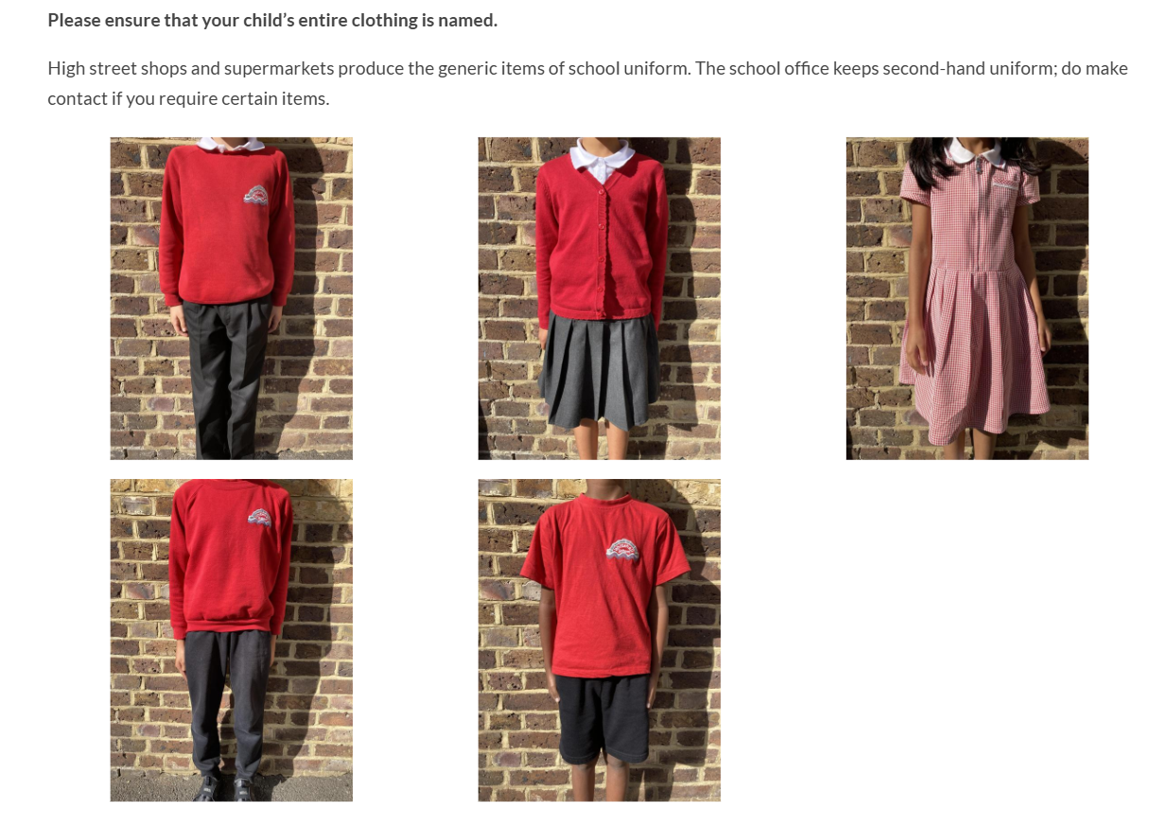
Our school uniform

Slide 23
What our girls are expected to wear?
Girls
School’s red sweatshirts or cardigans are available from our school uniform supplier (PMG Schoolwear);
White shirt/blouse or white polo shirt;
Grey or black school skirts, school trousers or pinafore dresses; (Strictly no leggings)
Red and white gingham dress for the summer, if desired;
Grey or white socks;
Red or grey tights;
Sensible all-black leather school shoes, NOT boots, shoes with heels or trainers
Strictly white hijab only

Slide 24
What are our boys expected to wear?
Boys
School sweatshirts are available from our school uniform supplier (see details below);
White shirt or white polo shirt;
Grey or black school trousers or grey school shorts;
Grey or white socks;
Sensible all-black leather school shoes, NOT boots or trainers

Slide 25
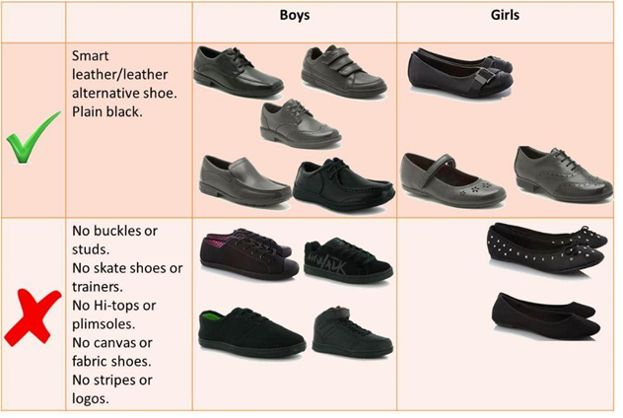
School shoes

Slide 26
School Clubs
A huge programme of clubs on offer each term.
https://www.whitehalljunior.org/school-clubs-1/
Competition Clubs: Rugby, football, cross-country, netball, athletics, etc.

Slide 27

School Clubs

Slide 28
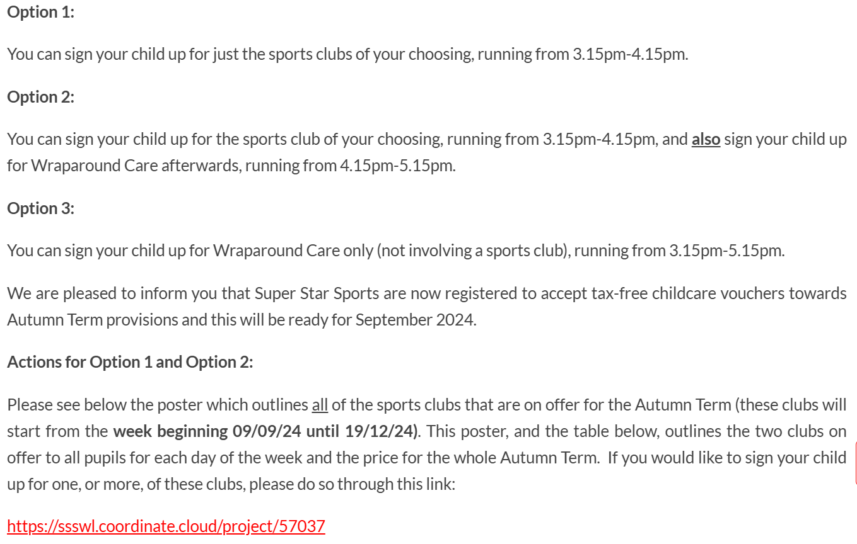
School Clubs

Slide 29
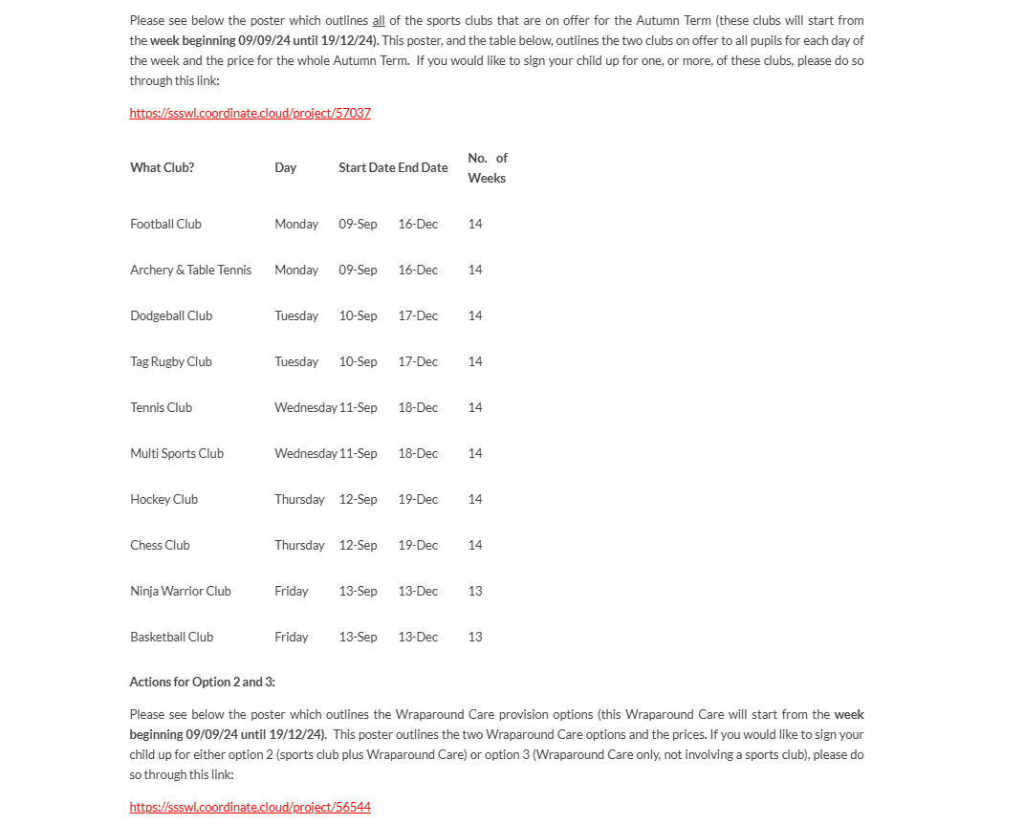
School Clubs

Slide 30
Parent Login Details
EduSpot: login details currently being set up
‘How to access’ details will be emailed out to you before summer holiday
School lunches, trips, production tickets
Generally: e-Communication: regular newsletters/ general information

Slide 31
Our Website: Key source of information
Monthly newsletter
Contact Year 3 team for non-urgent matters on:
year3@whitehalljunior.org
Class Assembly notification
Year 3 Parent and Class Pages
www.whitehalljunior.org

Slide 32
Any questions & tour of Year 3
Any questions before you start in September 2024.
First meeting in new academic year:

