Slide 1

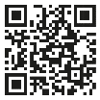

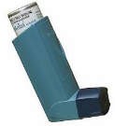

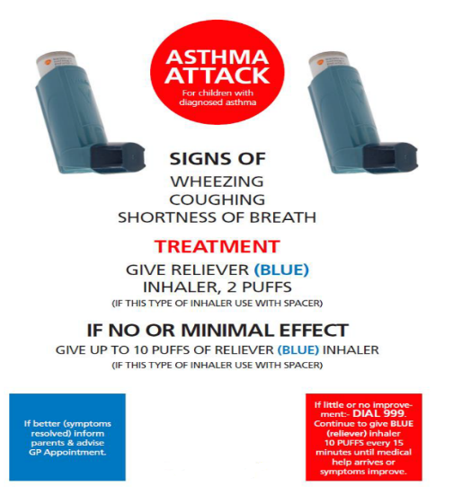
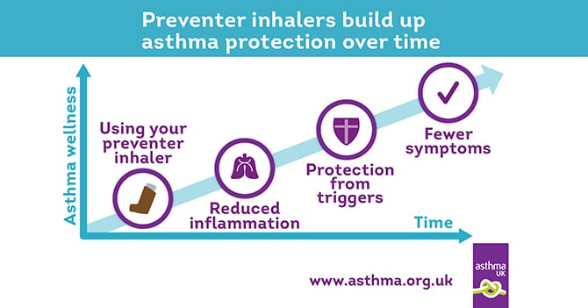
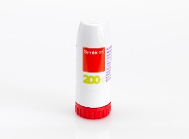
ASTHMA NEWSLETTER
Spring 2024
ASTHMA INFORMATION
Your School Nurse can be contacted to provide information and guidance on the following:
Developing your asthma policy.
Ongoing support with asthma.
Whole school training.
Raising concerns about children’s asthma control.
SCHOOL NURSE CONTACT DETAILS:
TELEPHONE: 01895 891 302
EMAIL : cnw-tr.hillingdonchildrencc@nhs.net
WEBSITE : www.hillingdoncyp.cnwl.nhs.uk/
On our website, you can find more information about Asthma.
You can also contact your allocated school nurse directly if you have any concerns about a child.
REMEMBER!
Complete and email asthma monthly return forms, helping to identify children who need extra support to control their asthma! Email the forms to:
thh-tr.PaedAsthma@nhs.net
DON’T FORGET!
Get your whole school training booked This is an annual requirement - 85% of staff must attend.
Book to do your asthma audit with your school nurse – this helps your school achieve asthma friendly status!
Emergency inhaler kits:
This must contain 2 inhalers and 2 spacers. If used, the inhaler can be wiped clean and the chamber can be washed in warm soapy water and be allowed to air dry, both can then be used again for another child.
Copy of the emergency plan.
Monthly checks record.
List of asthmatics who are permitted to use the inhaler.
Consider how many kits are needed in your school and ensure staff know where these kits are!
ACHIEVE ASTHMA FRIENDLY STATUS:
Named Asthma lead and Asthma Champion.
Asthma Champion to attend annual update.
Register of all known Asthmatics.
Has a clear Asthma Policy.
Allows easy access to inhalers.
Annual whole school staff training .
Displays emergency plan around the school.
Emergency Kits
Annual Asthma audit completed.
Monthly asthma form.
Please ensure emergency plans are around the school – contact your school nurse if you would like more.
Symbicort
Reliever & Preventer 2-in-1 device / medication.
Rarely used in primary school but being prescribed for some secondary school students
The child or young person uses it as a preventer and reliever so there is no need for them to have a Salbutamol (Blue inhaler)

